Slide 1

ADOxx E-Learning
e3Value
PP2, HSR

Slide 2
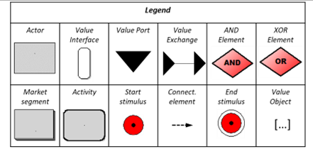
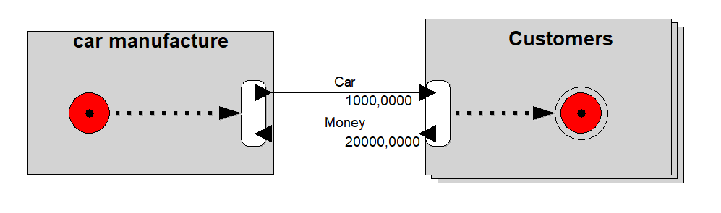
E3Value a Modeling Approach for Network Business Models
The e3Value method is a modeling approach designed to analyze and visualize value relationships within network business models. It enables the representation of value exchanges between actors who collaboratively create, exchange, and consume value. The method serves as a tool to explore innovative business ideas and assess their economic feasibility.
Key Elements of e3Value:
Actors: Independent economic entities.
Market Segments: Groups of similar actors.
Value Activities: A value-creating operation that promotes operational transparency within an actor.
Value Interfaces: Encapsulates value exchanges and ensures two-way trading by facilitating both offering and receiving of value objects.
Value Ports : Enable the offering or consumption of value objects (indicate the direction of the value exchange).
Value Objects: Represents exchanged goods, services, or money with value for one or more actors.
Value Exchange: Connects two value ports to transfer value between actors. Value objects represent the exchanged goods, services, or money.
Scenarios: Allow calculation of different business cases (BC) by connecting value interfaces with:
Start stimulus: The beginning of a scenario.
Stop stimulus: The end of a scenario.
Logical operators (AND/OR) represent operations and enable modeling of multiple business models within a single network business model (NBM).
Dependency Paths / Connection Element:
Use connection elements to link start/stop stimuli, value interfaces, and logical operators.
Facilitate scenario creation by defining the flow of value exchanges and logical dependencies across the NCM.

Slide 3
E3Value a Modeling Approach for Network Business Models
Objective:
Link operations and infrastructure requirements to validate the business model's nine building blocks (BMC).
Analyze value exchange relationships and simulate economic feasibility through "What-if" scenarios.
Activities:
Conduct a collaborative modeling workshop with key stakeholders to validate the business model's value dimensions.
Map BMC/BPMN components (e.g., Key Partners, Customer Segments, Activities) to e3Value.
Analyze actors, value exchange relationships, and infrastructure needs (e.g., facilities, equipment).
Simulate "What-if" scenarios for Value Capture, Delivery, and Creation, focusing on costs, revenues, and market dynamics.
Output:
Validated BMC with integrated insights into operations and infrastructure.
Simulated KPIs (costs, revenues, and profits).
Defined infrastructure and resource requirements for business model implementation.

Slide 4
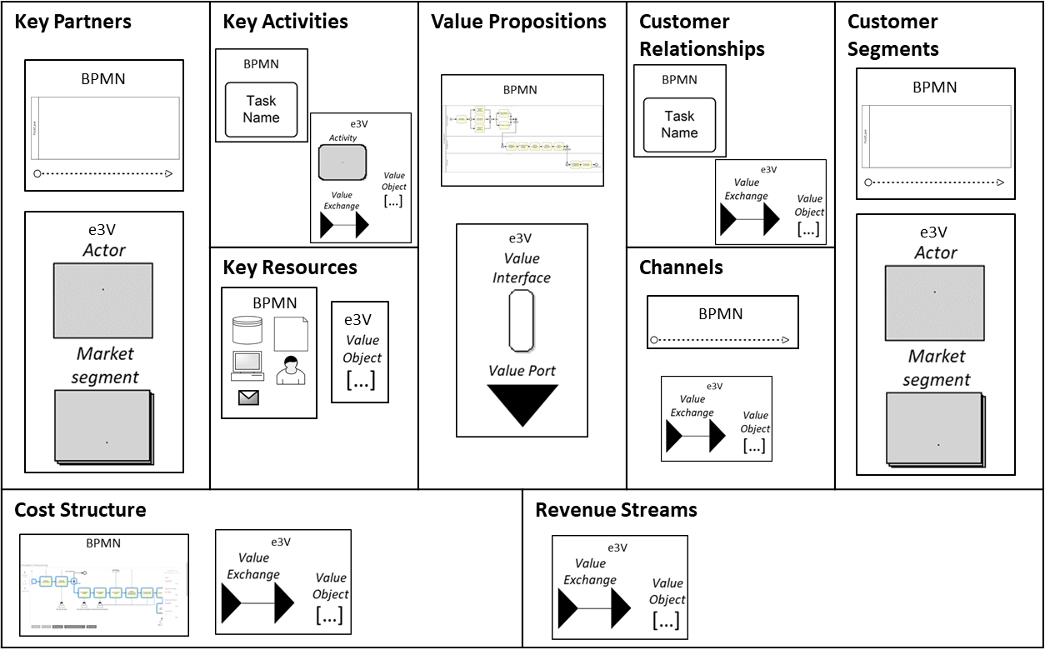
BMC, e3Value and BPMN

Slide 5

Form BMC to a network business model
Modeling and simulation of a value network (Structure Modell)
Differentiation of customers into homogeneous segments
Differentiation of the offered products/services
Listing of all (relevant) actors: suppliers, service providers, etc.
Listing of all value exchanges in the value chain according to price-quantity-specification
Period of the simulation e.g. 5 years
Market volume

Slide 6
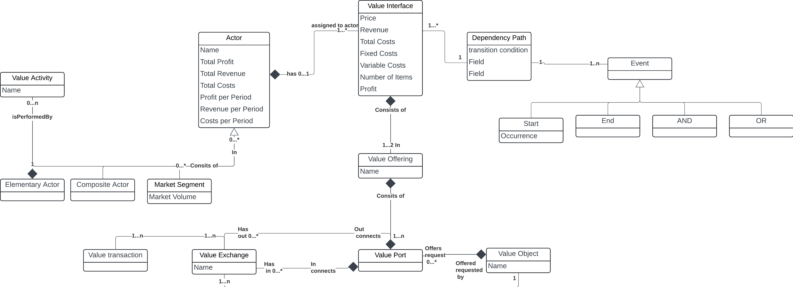
e3Value

Slide 7
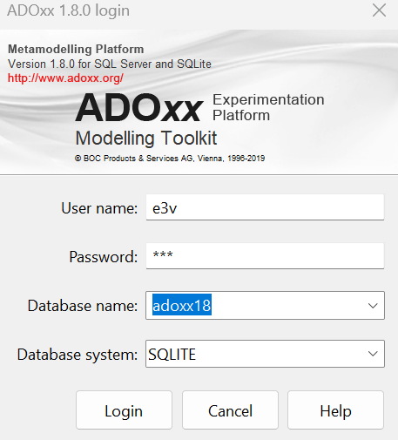
Getting Started
Launch the ADOxx Modeling Toolkit and log in using your user credentials.

Slide 8
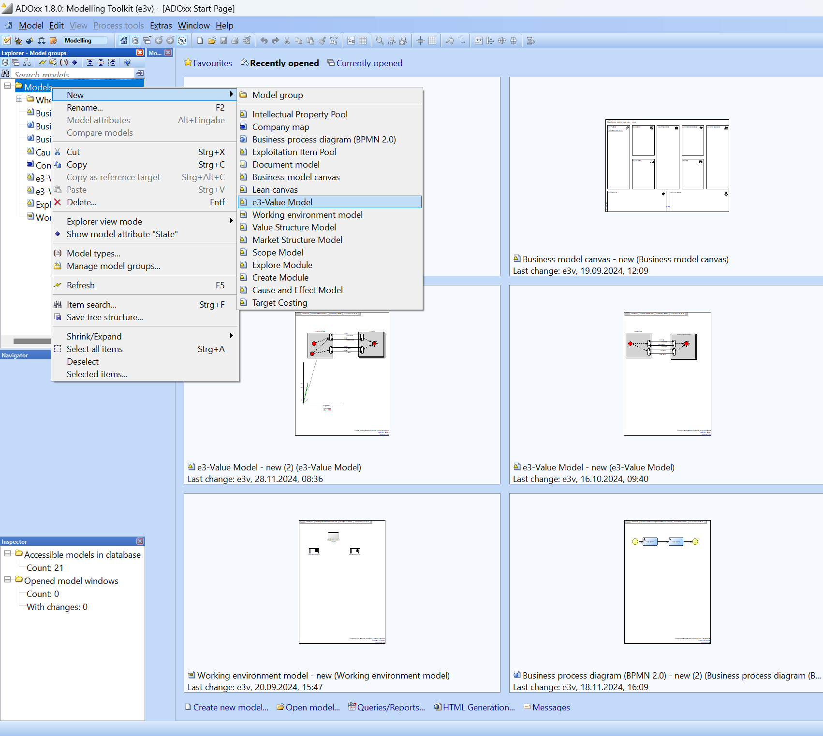
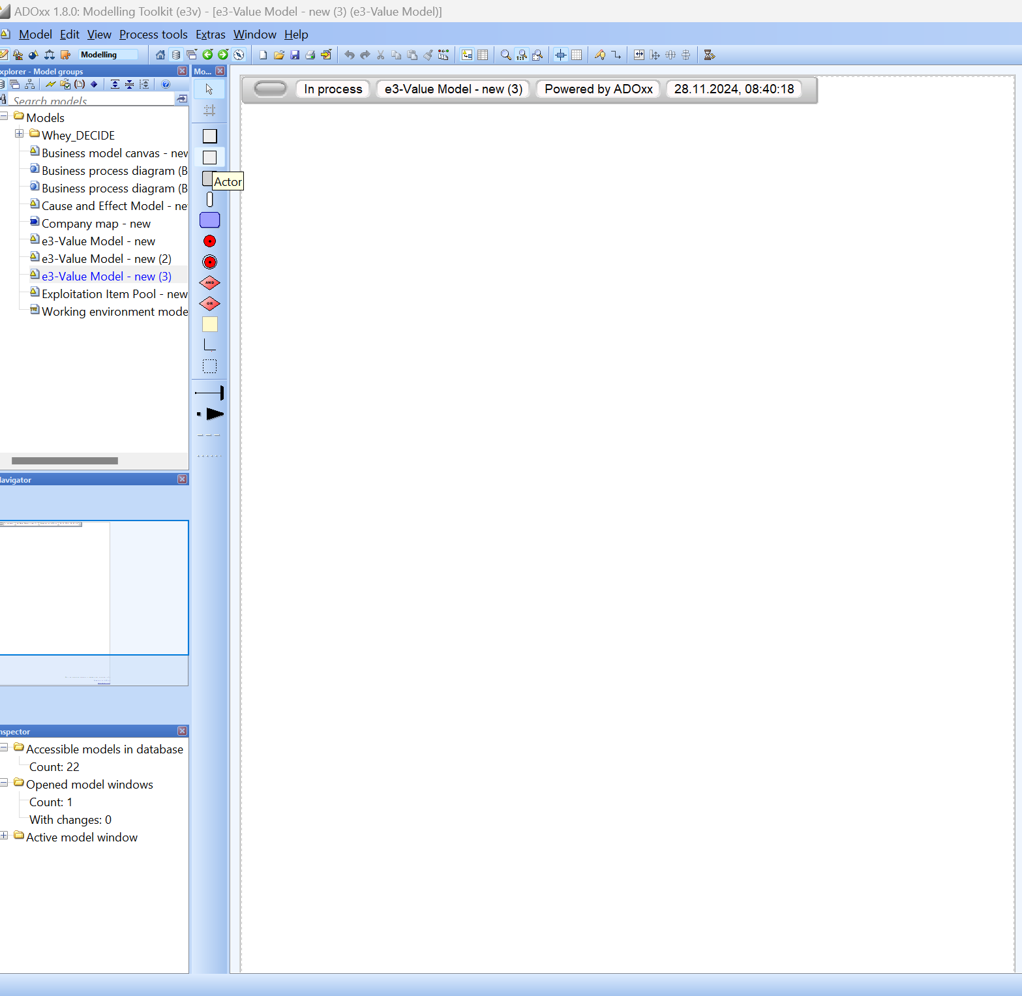
Creating a New e3-Value Model
After creating or selecting the e3-Value button in the dialog box, the interface for creating a new e3-Value model appears. On the right side, the palette allows elements to be selected by clicking and then placed on the canvas with another click. Each additional click creates a new object of the selected entity. The process can be canceled by right-clicking or pressing the Esc key.
By right-clicking on the Models folder, a context menu appears. Select New from the menu and then choose e3-Value Model to create a new model.

Slide 9
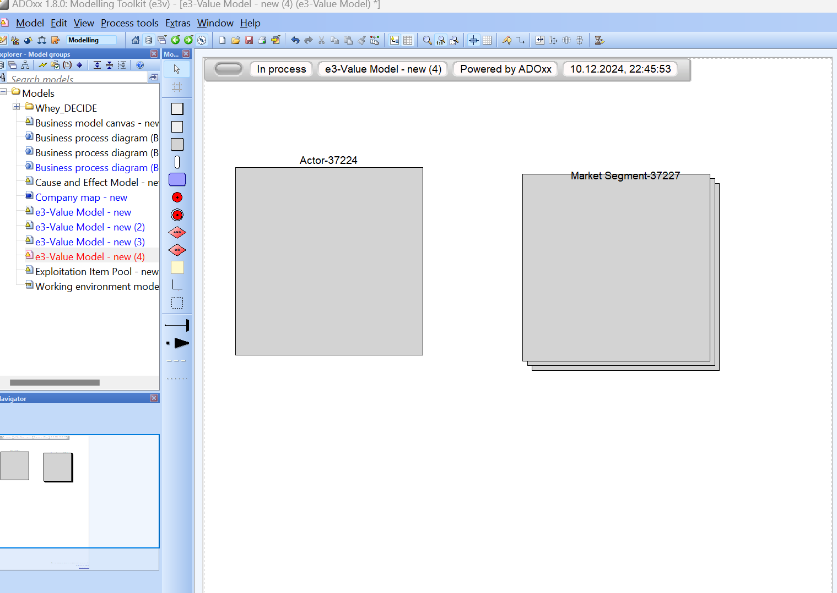
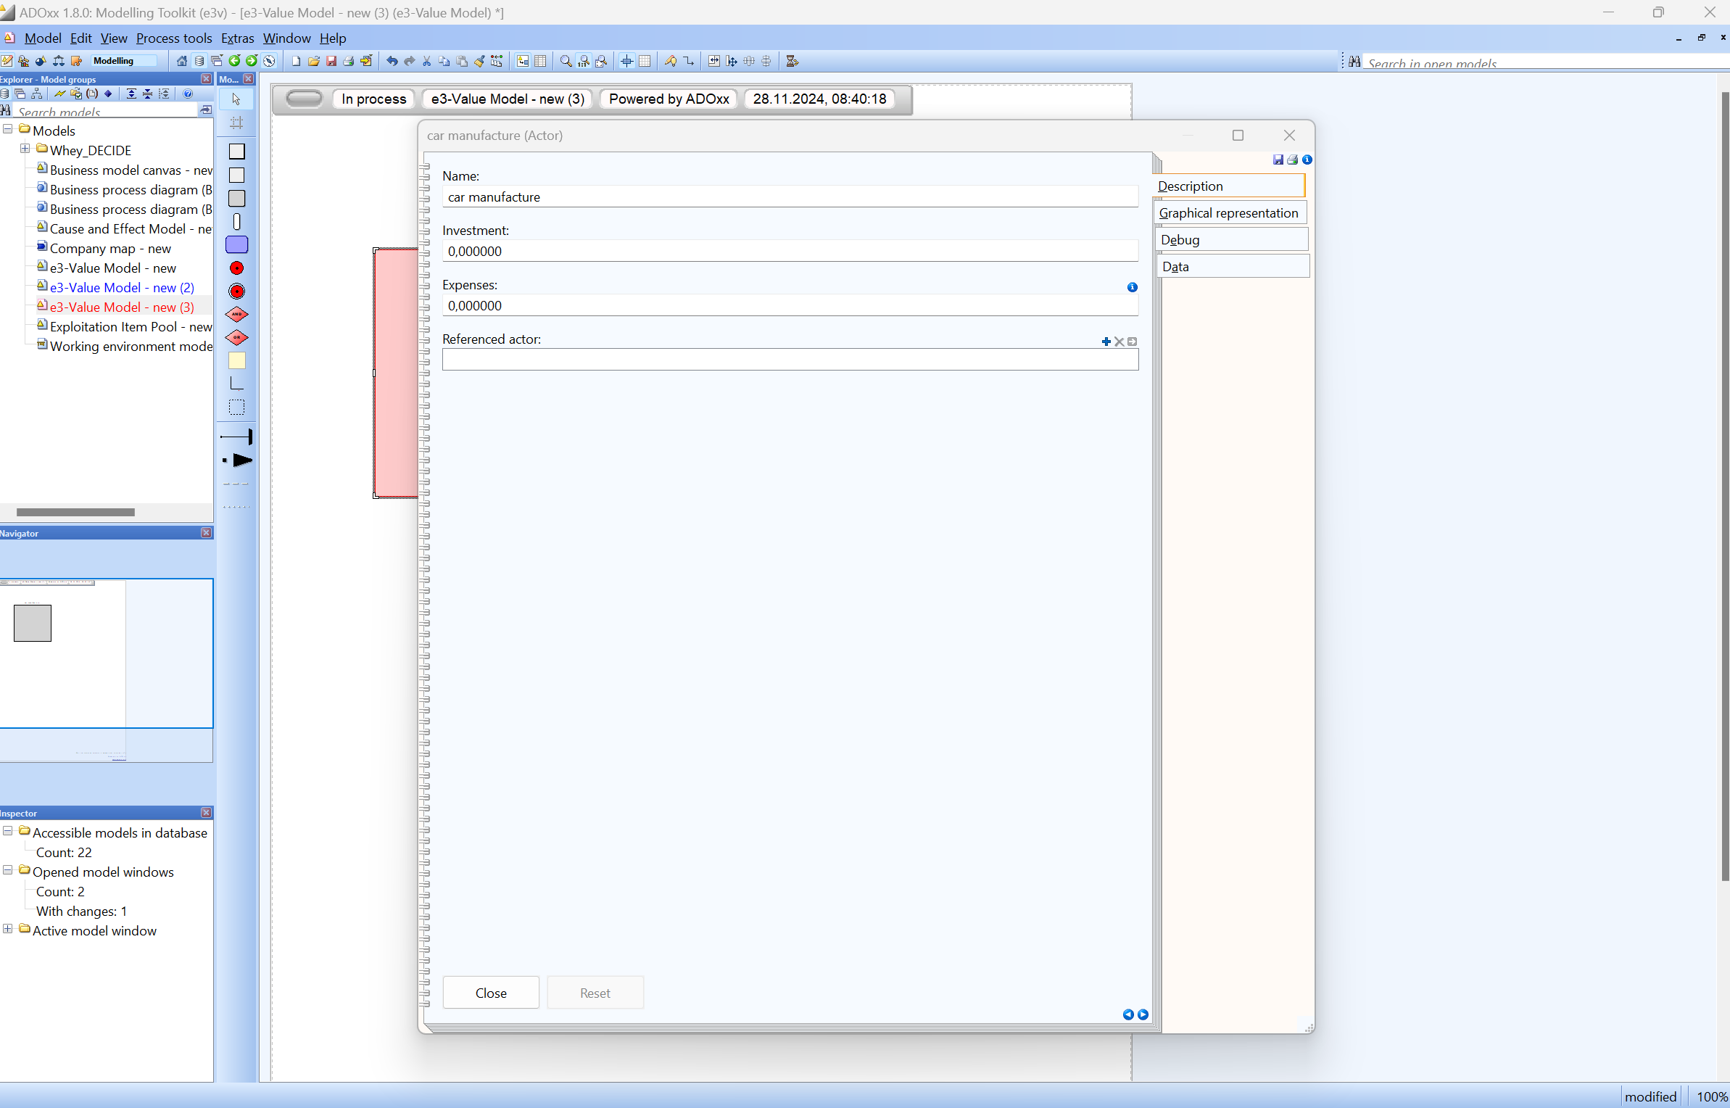
Configuring Actors and Market Segments in e3-Value
By selecting from the palette, we now add an Actor and a Market Segment to the canvas.
Double-clicking on an entity, such as the Actor, opens the context menu, also referred to as the Notebook.
Here, various settings can be configured.
First, we change the name of the Actor to Car Manufacturer and the Market Segment to Customer.
Additionally, under Graphical Representation, options such as font customization can be adjusted. It is also possible to specify whether the name appears inside or outside the entity and its position (top, middle or down).

Slide 10
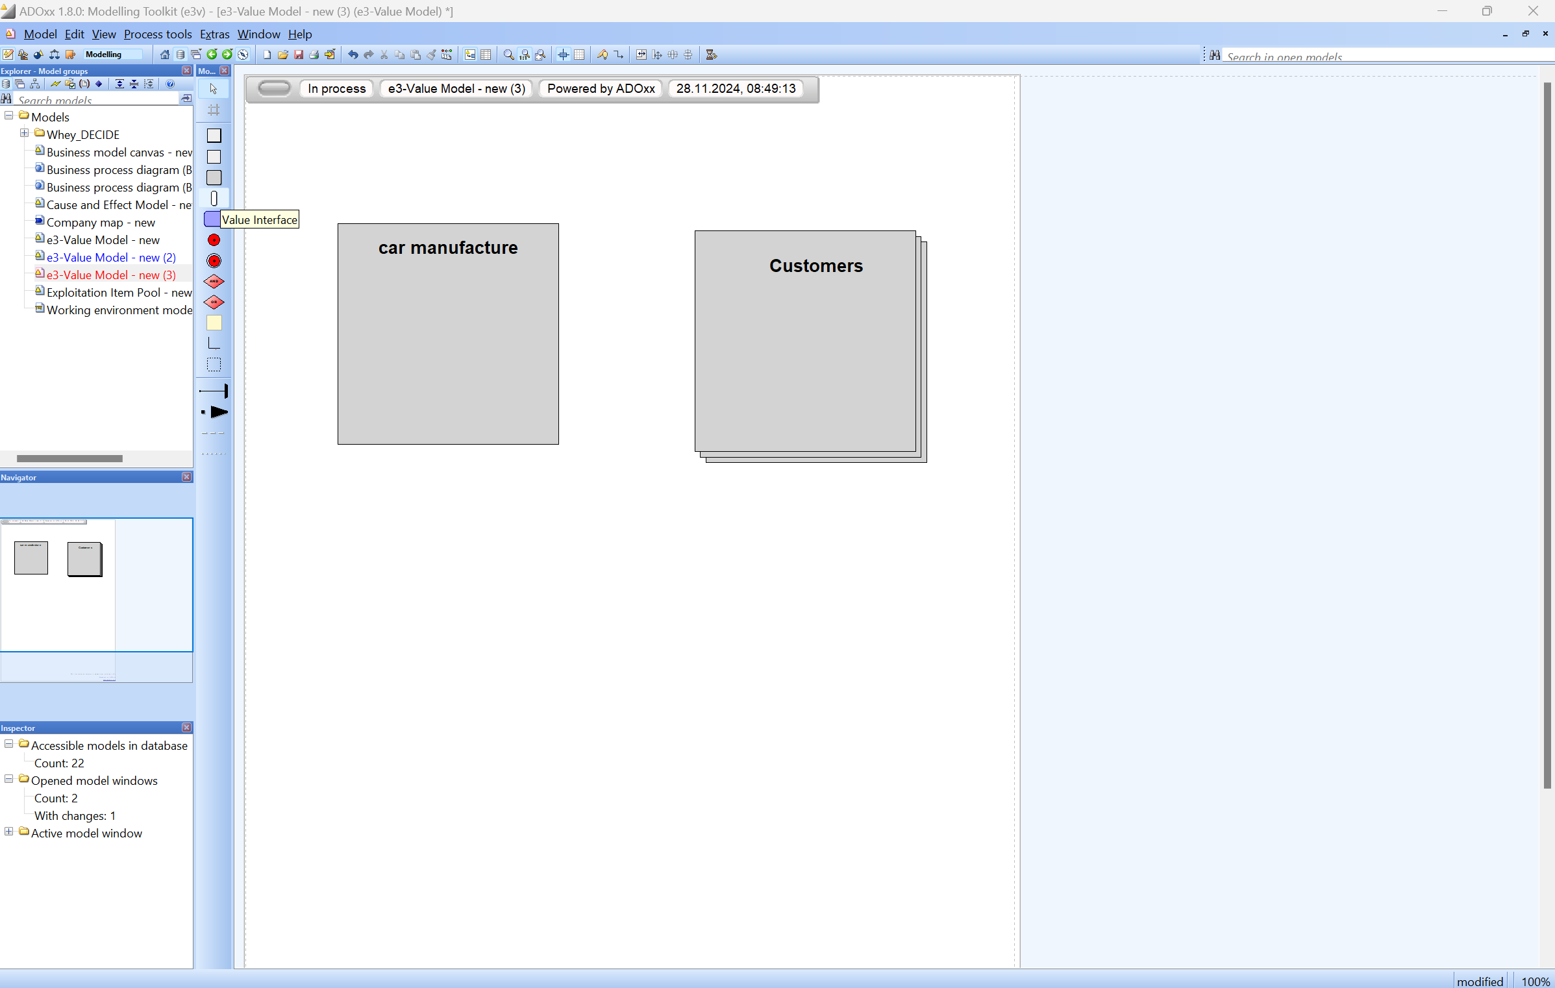
Configuring Actors and Market Segments in e3-Value

Slide 11
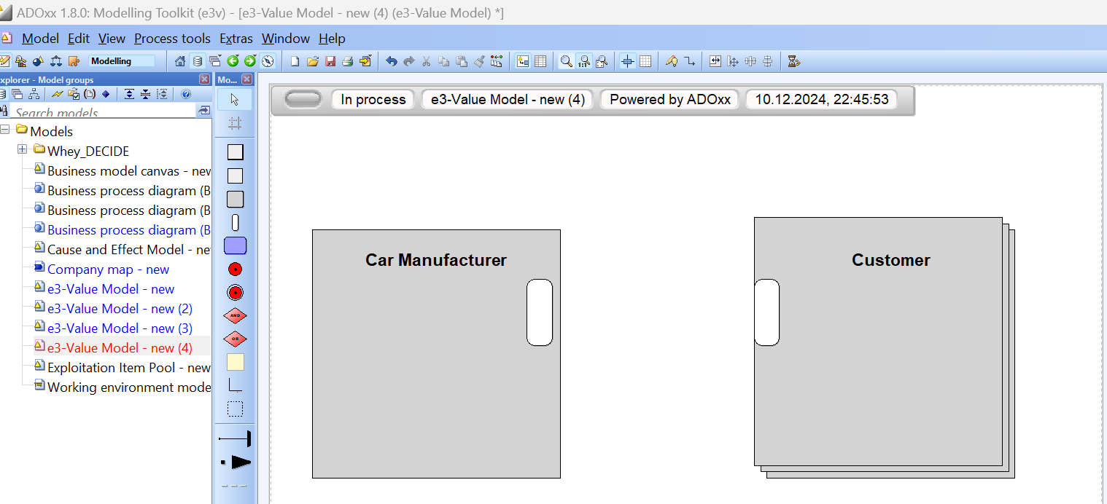
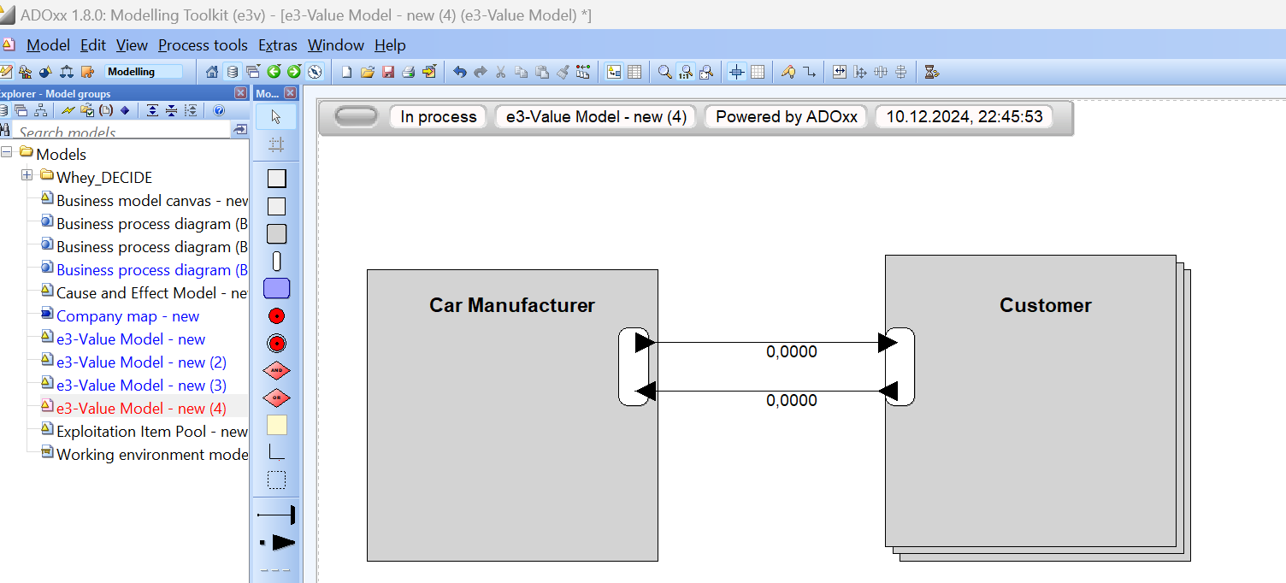
Adding and Positioning Value Interfaces in e3-Value
In the next step, Value Interfaces are added to the model. They represent which Value Exchanges, Ports, and Objects are encapsulated within a Value Offering.
First, we place two Value Interfaces on the canvas: one for the Car Manufacturer and one for the Customer.
These are then connected using Value Exchanges, which, in this implementation, also include the Value Ports.
Value Interfaces must be placed within an Actor or Market Segment, as the simulation later checks whether a Value Interface is associated with an entity. Therefore, they should be positioned at the edge of the respective entity and close to the Value Interface of another entity they will connect to via Value Exchanges.
Each Value Interface can have up to two Value Exchanges, which should flow in opposite directions, based on the assumption that every offering is accompanied by a corresponding return.

Slide 12
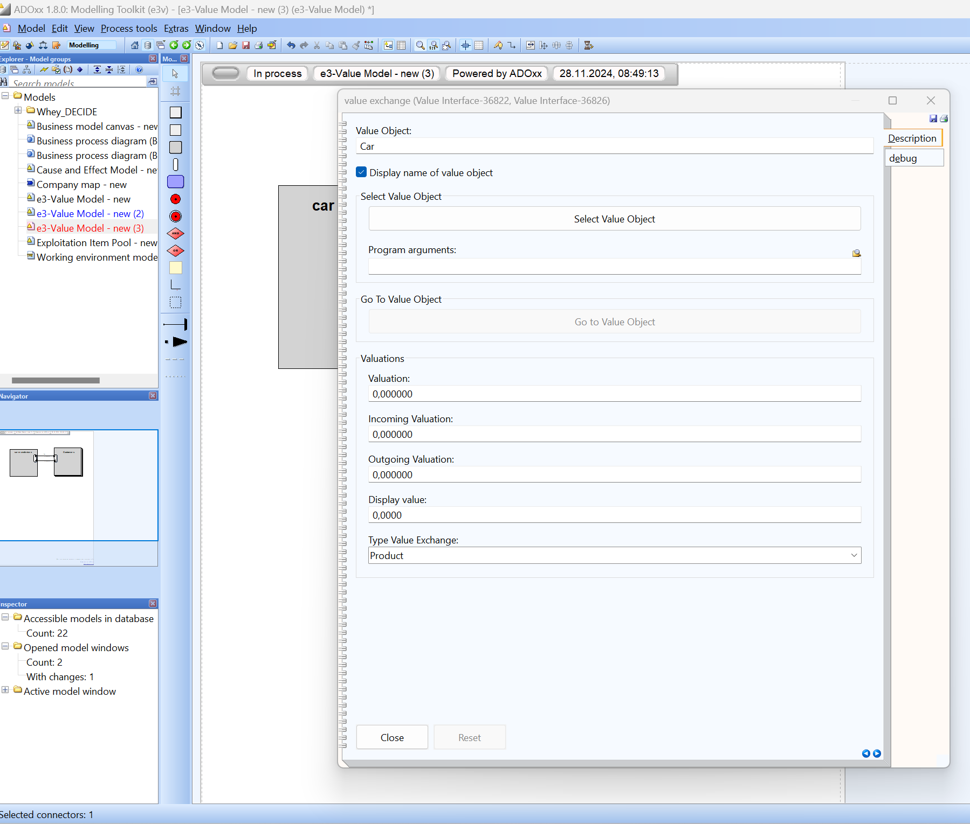
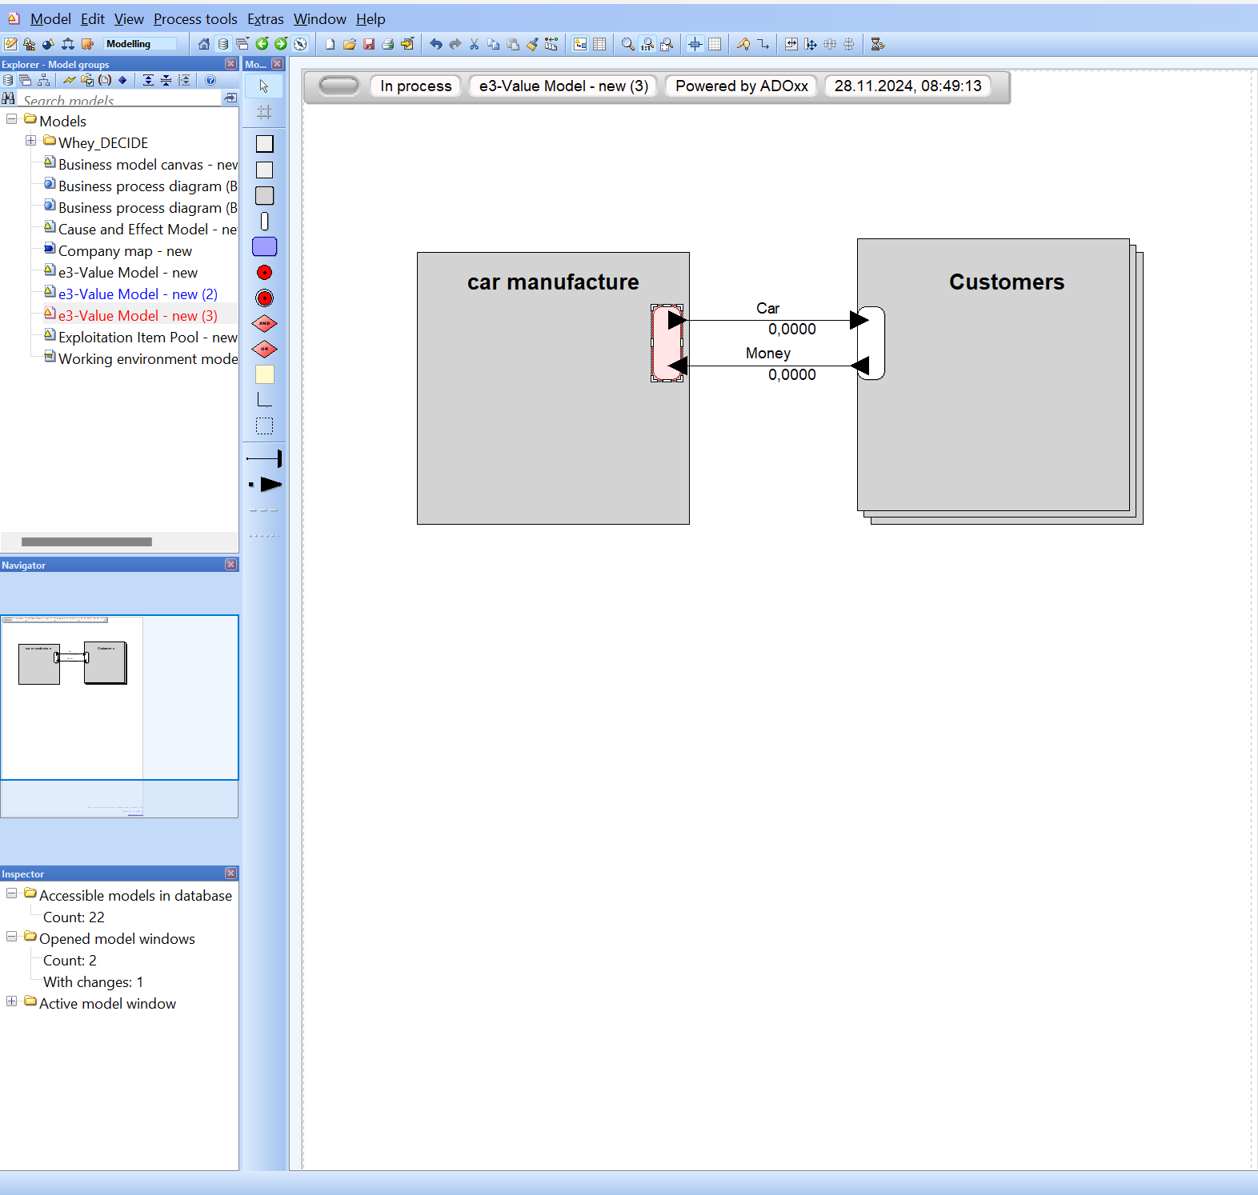
Specifying Value Objects for Value Exchanges
By double-clicking on the Value Exchanges, a name can be assigned under Value Object, which is then displayed along the edge of the Value Exchange.

Slide 13
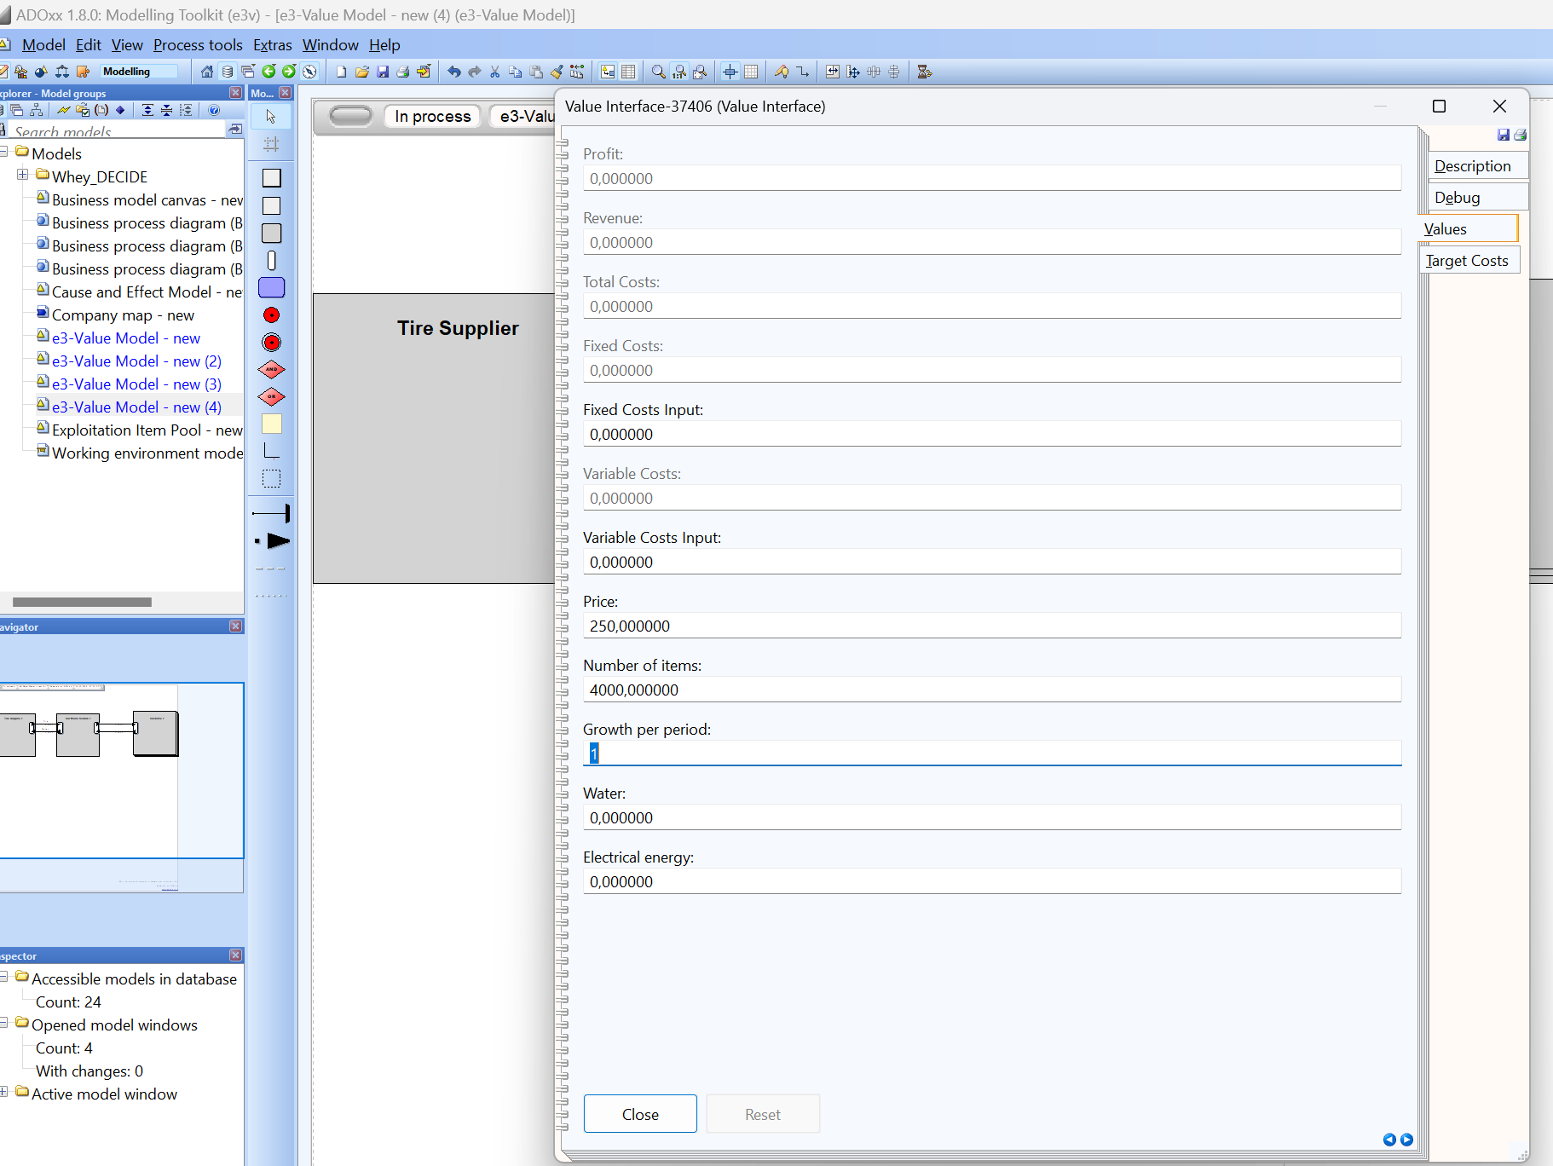
Specifying Economic Parameters in the Value Interface and Expanding the NBM: Tire Supplier
New Actor: Tire Supplier provides tires to the Car Manufacturer.
Value Interfaces: Add two interfaces (Tire Supplier and Car Manufacturer) connected via Value Exchanges with the Value Object Tires and Money.
By double-clicking the Value Interface of the Tire Supplier, the following economic parameters are specified:
Economic Parameters:.
Number of Items: 4,000 tires (1000 cars x 4 tires).
Specifies the quantity of products sold per period
Example: The Car Manufacturer produces 1,000 cars, requiring 4,000 tires.
Price:
The price paid by the Car Manufacturer per tire.
Example: €250 per tire.
Other Parameters: Fixed and Variable Costs can be ignored for the Tire Supplier.

Slide 14
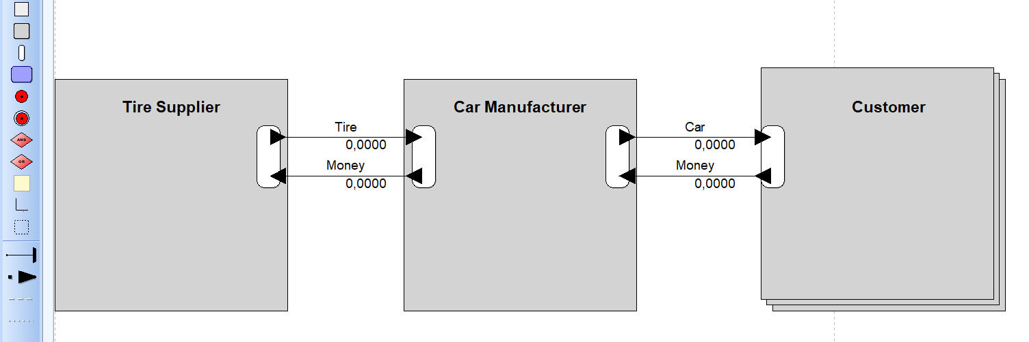
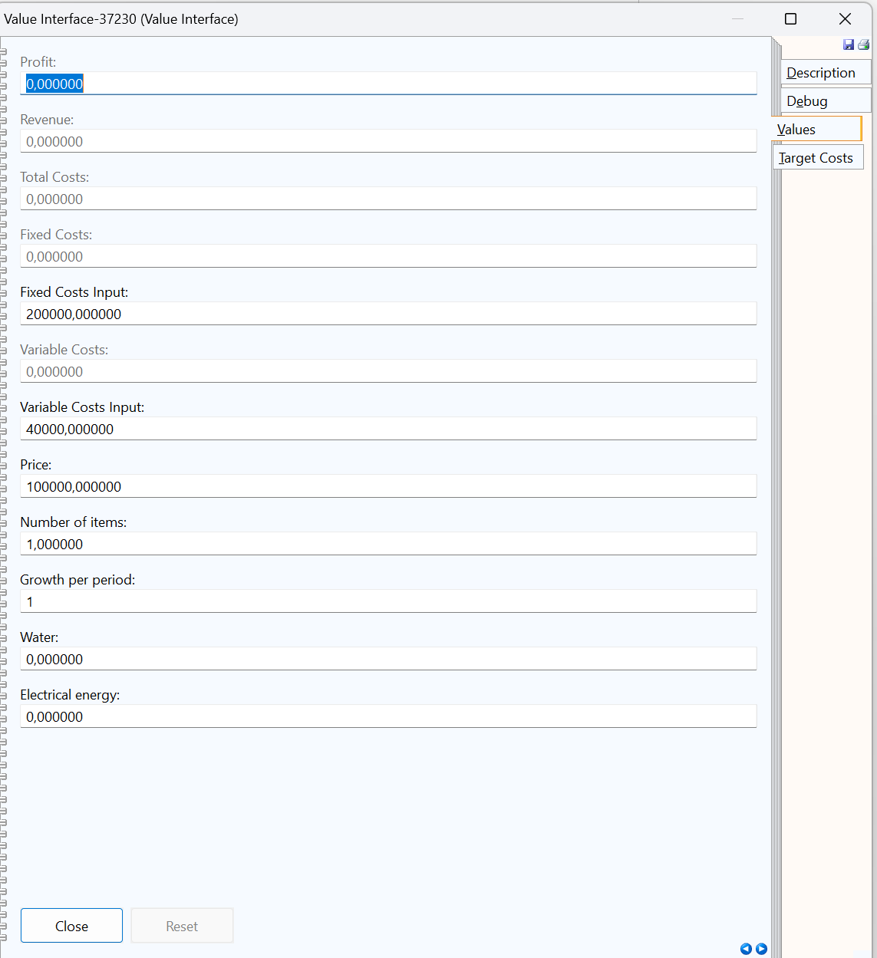
Specifying Economic Parameters in the Value Interface
Double-clicking on the Value Interface of the Car Manufacturer allows economic parameters to be defined. As a prototype, the simulation focuses on selected elements.
Parameter Settings:
Number of Items
Specifies the quantity of products sold per customer and period (e.g., month or year).
Set to 1 vehicle, as it is not expected that more than one car will be sold to a single customer.
Price per Product (Price)
Defines the selling price per unit.
Fixed Costs
Remain constant regardless of production volume.
Cover infrastructure or other fixed expenses.
Variable Costs
Increase proportionally with production volume.
Include costs such as materials or production costs per unit.

Slide 15
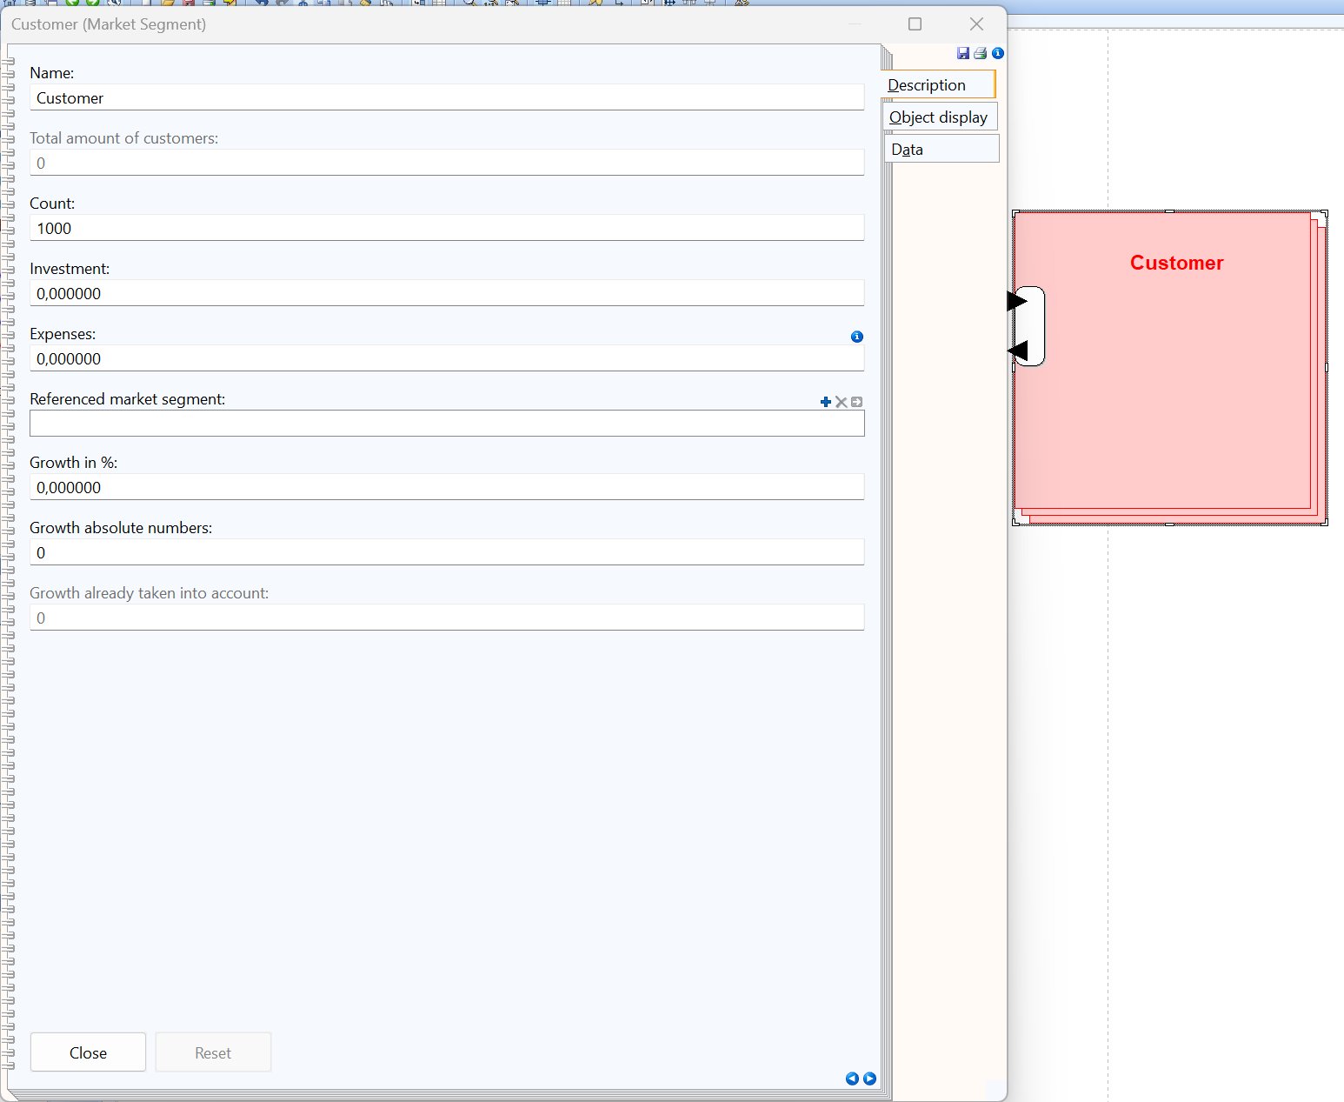
Adjusting the Market Volume
Click on the Customer Market Segment.
Parameter:
Under Count, define the number of customers or the market volume per period.
Example: 1000 cars per period.

Slide 16
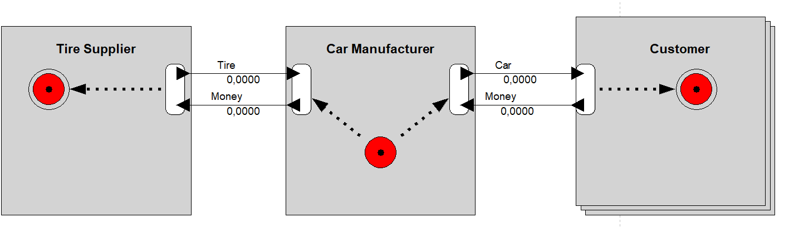
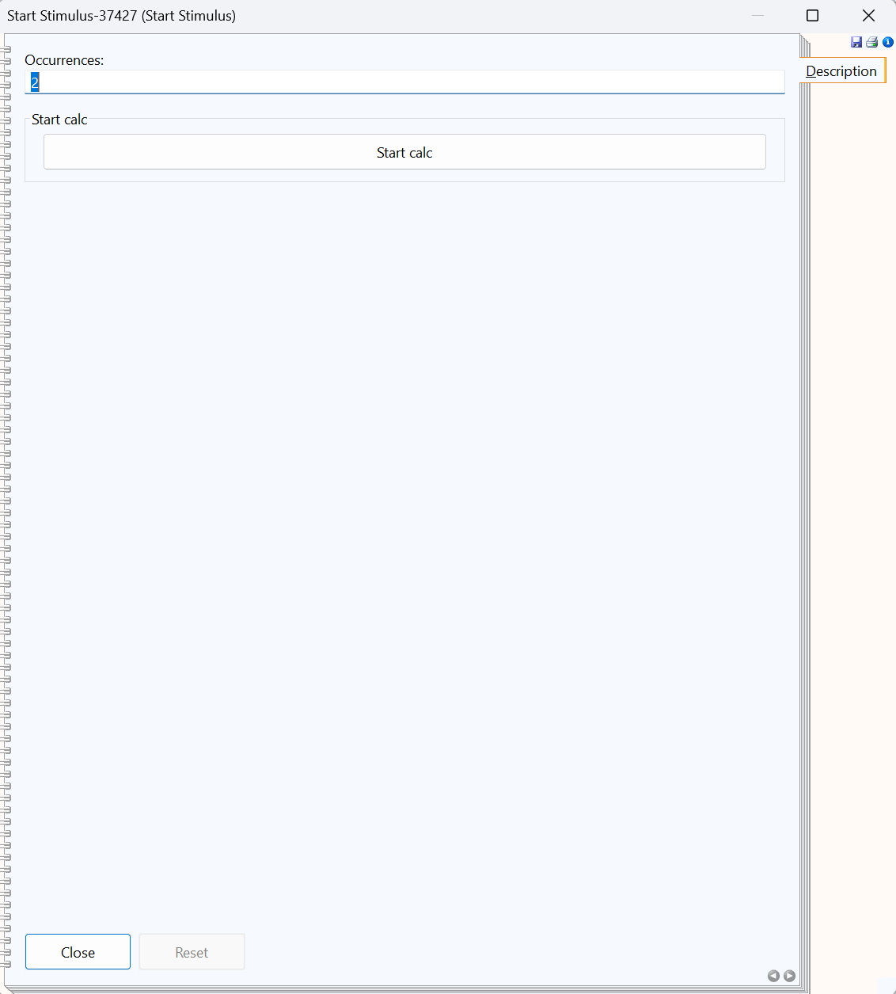
Adding Start and Stop Stimuli and configuring the Start Stimulus
Place Start and Stop Stimuli on the canvas.
Connection: Link the stimuli using Connection Elements (Dependency Paths).
Double-click the Start Stimulus to set the Occurrences count.
Specifies the time span for the simulation, e.g., 2 years.
Note: The number is dimensionless and must be interpreted and contextualized by the user.
Press Start Calc to execute the simulation.

Slide 17
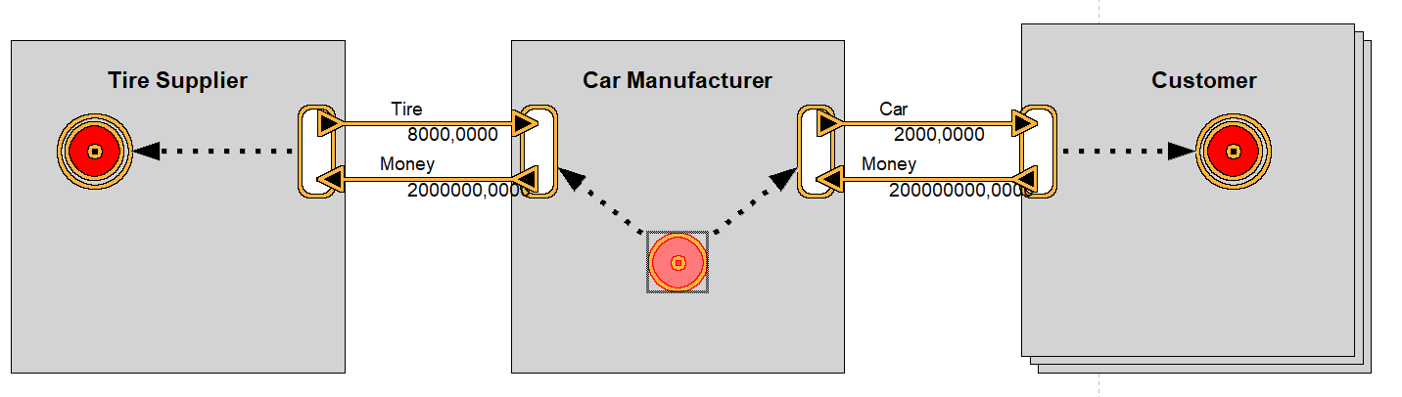
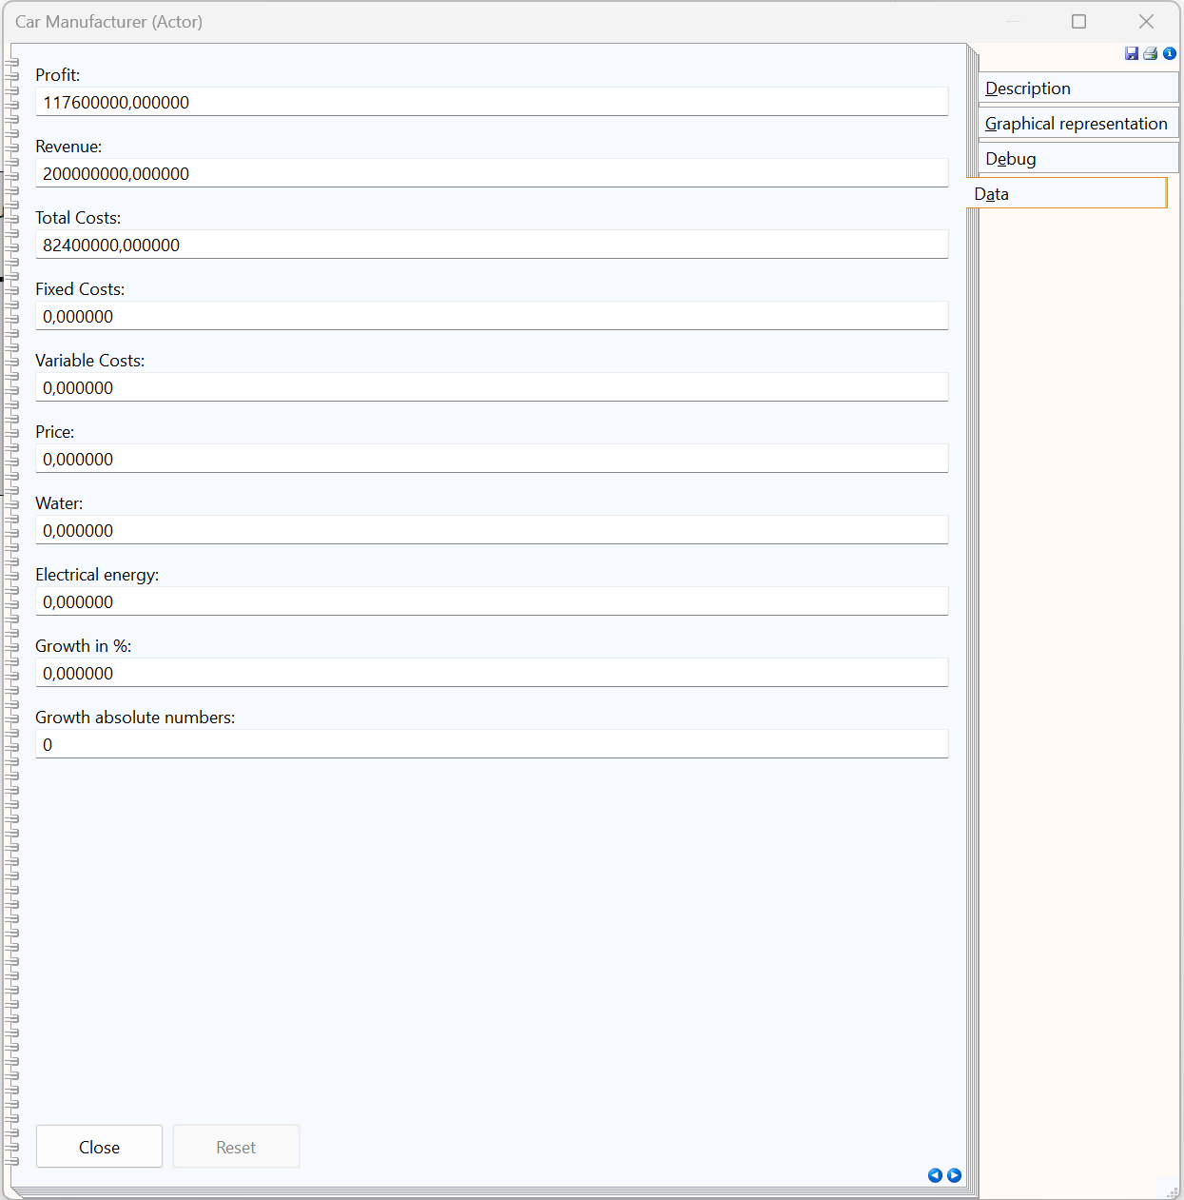
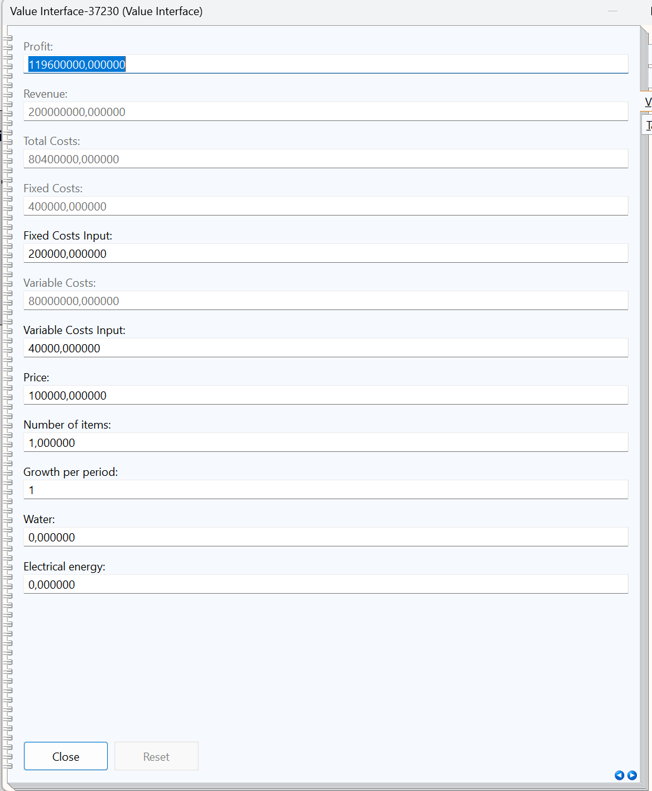
Simulation and Analyzing Simulation Results
All Value Interfaces, Value Exchanges, and Start/Stop Stimuli are highlighted during the simulation.
Path Completion:
Each Value Interface (e.g., for the Tire Supplier and Customer) must be completed with a Stop Stimulus.
This ensures the algorithm recognizes the end of a path and can verify if additional paths are available for simulation.
By double-clicking on the Value Interfaces, individual transactions can be viewed under the Values tab.
Example: What represents costs for one actor translates to revenue and potential profit for another.
Actor-Level Analysis:
Key metrics such as Profit, Revenue, and Cost for each actor are displayed under the Data tab.
Detailed Simulation Results:
The Debug tab provides detailed totals for each period on the actor level:
TotalCostArray, TotalProfitArray, TotalRevenueArray
Actor-Level Car Manufacturer
Value Interface Car Manufacturer to Customer

